Slide 1
Running Open-Source Machine-Learning Models On-Premises
Malte Groth

Slide 2
This talk in one diagram
“Providing access to Open-Source Machine-learning Models via self-hosted Web-Services for Inference”
on-premises infrastructure
App
http
API
Model
ModelHubs
App
gRPC
ModelServingRuntime
App

Slide 3
What does it have to do with medicine?
This Setup is necessary for many applications in medicine dealing with AI for several reason.
In medicine, there is need for
Data Security, e.g. because of sensitive data
Transparency & Reliability, e.g. for science and traceable services
Autonomy & Avalability, e.g. for not being dependent on internet providers
Adaptability, e.g. in terms of fine-tuning
...

Slide 4
Running Open-Source Machine-Learning Models On-Premises

Slide 5



Open-Source Machine-Learning Models
… are models available under an Open-Source License (e.g. Apache 2.0)
Sources: HuggingFace, PyTorchHub, Github
Open-Source models differ in terms of transparency, reproducibility and quality control
→ Do not confuse Open-Source with Openness

Slide 6
Advantages of Open-Source Machine-Learning Models
Transparency and Reliability
Availability
Adaptability
Performance
Autonomy (avoiding Vendor-Lock-In)
Cost-Saving

Slide 7
Running Open-Source Machine-Learning Models On-Premises

Slide 8
On-Premises
Deployments and operations are located within physical premises of a company/organization
Opposite of the cloud
Full control over IT infrastructure, data and applications

Slide 9
Motivation for running Models on-premises
Data Security and Privacy
Latency and Performance
Cost-Saving
Offline Access
Control over intellectual property
Flexibility → especially true if following a ...

Slide 10
Cloud-agnostic deployment strategy
Designing your Applications, tools and services in a way so they can migrate seamlessly between multiple cloud platforms and on-premises.
AWS
On-Prem
GCP
Application
Azure
On-Prem
STACKIT

Slide 11
Kubernetes
… is a key technology for implementing a cloud-agnostic deployment strategy because it
abstracts the underlying infrastructure
has a consistent tooling and user interface
provides scaling at ease
"Kubernetes (k8s) is a ...
open-source
container orchestration system
for automating software deployment, scaling and management."

Slide 12
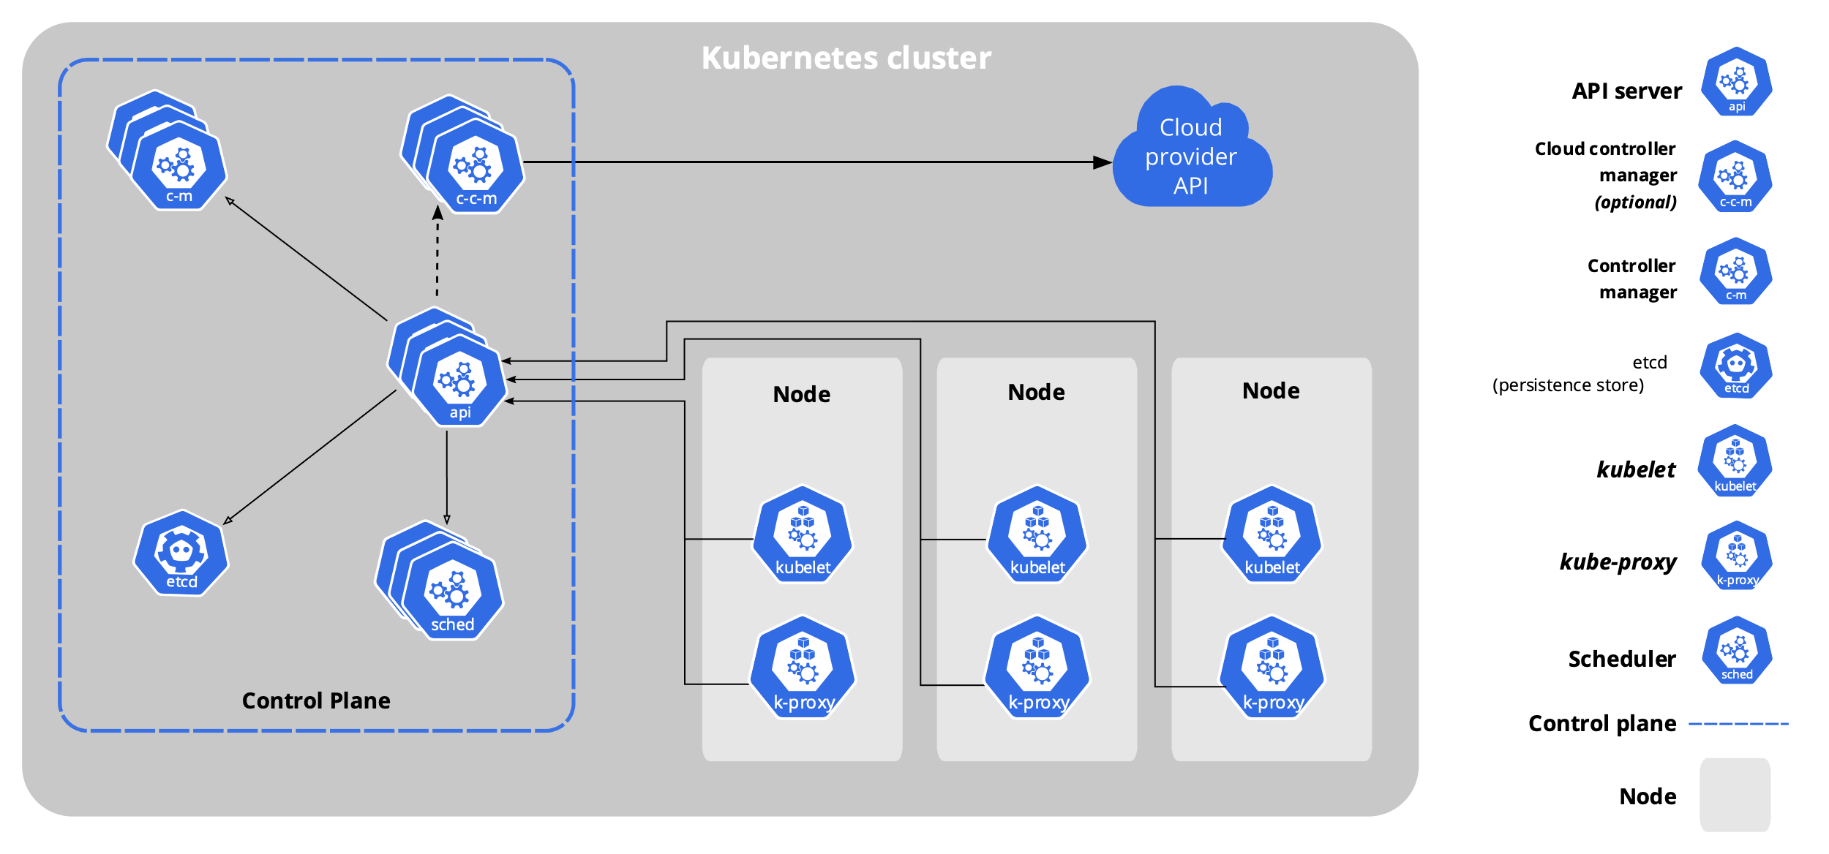
Kubernetes
Kubernetes Cluster simplified and from a user perspective:
web service that can be used to manage and automate processes on many computers

Slide 13
Running Open-Source Machine-Learning Models On-Premises with Kubernetes

Slide 14
KServe: Model Inference Platform on Kubernetes
KServe
offers (auto)scaling, e.g.
if number of requests increases
if there is no load at all (scale to zero)
standardized inference protocol across ML frameworks and Model Serving Runtimes
simplifies model deployment

Slide 15
Running Open-Source Machine-Learning Models On-Premises In Practice

Slide 16
Demo: Steps to run a Model for ImageClassification from torch.hub on Kubernetes
Setup:
local Kubernetes-Cluster based on Minikube
KServe is already installed
Model for Image Recognition: resnet18 from torch.hub
Model files were already downloaded
Steps:
Preparing the model files: create a MAR file so that torchserve can work with the model
Uploading the MAR file
Creating an InferenceService with references to the location of the model and the model serving runtime to be used
Preparing images and classifying them via HTTP requests

Slide 17
Summary
Open-Source Machine-Learning Models have a lot of advantages.
There are many reasons why it may be appropriate or even necessary to deploy models on-premise for a medical use case.
You can gain high flexibility by choosing a cloud-agnostic approach.
Kubernetes is a key technology for implementing a cloud-agnostic deployment strategy.
KServe is a inference platform suited for deploying models in production on Kubernetes.

Slide 18
Thank you for your attention

Slide 19
Why Kubernetes?
High Availability:
K8s clusters consists of multiple nodes
K8s controllers enable service (pod) replication
K8s controllers provide self-healing mechanisms
Resource Efficiency:
K8s comes with a powerful scheduling
Link: https://dzone.com/articles/kubernetes-advantages-and-disadvantages

Slide 20
InferenceService
InferenceServices
provide Inference APIs out-of-the-box
support multiple ML frameworks/Model Serving Runtimes
support for obtaining models from different storage locations
provide Autoscaling, incl. Scale-To-Zero
"Since your model is being deployed as an InferenceService, not a raw Kubernetes Service, you just need to provide the storage location of the model and it gets some super powers out of the box 🚀."

Slide 21
InferenceService
Pod
API
MSR
Request
Model
Storage

